Slide 1

SIX SIGMA IN DENTISTRY
A Vision To Improve Quality Standards For A Multispecialty Dental Clinic

Slide 2

SIX SIGMA
Six Sigma is a disciplined, statistical-based, data-driven approach and continuous improvement methodology for eliminating defects in a product, process or service.
A six sigma level of performance has 3.4 defects per million opportunities (3.4 DPMO)

Slide 3
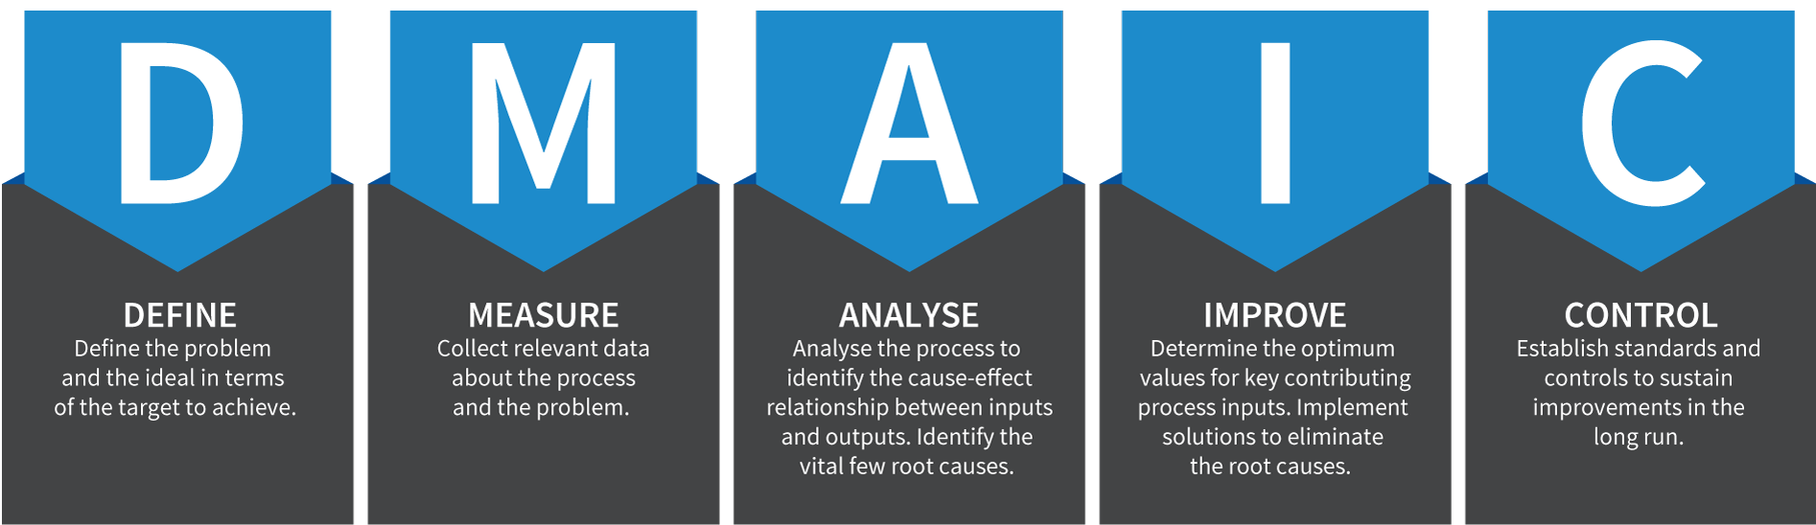
DMAIC PROCESS
DMAIC(Define, Measure, Analyse, Improve and Control) refers to a data driven quality strategy for improving, optimising and stabilising business processes and designs.

Slide 4

Signature Smiles is a modern, hi-tech and ISO certified chain of multi-specialty dental clinics in Mumbai, India.
Their focus is to provide quality and comfortable dental care services to all patients based in Mumbai or from abroad.
Headed by Dr. Sandeep Khanna (BDS, MDS), Signature Smiles has a team of super specialists that is dedicated towards delivering all dental treatments under one roof.

Slide 5

DEFINE PHASE

Slide 6
VALUE STREAM PROCESS
Business Non Value Added | Value Added | Non Value Added
Patient is greeted by the receptionist | Patient is called inside the doctor's room | Patient arrives at the clinic
Patient is offered tea/coffee | Doctor examines the patient and begins/continues treatment | Patient sits in the waiting area and fills case sheet
International patients are provided drop-off facilities | Receptionist informs patient about payment details, medication, dosage etc. | After treatment, patient speaks to the receptionist
 |  | Patient leaves the clinic

Slide 7
GOAL STATEMENT
Give recommendations to reduce waiting time in the “Signature Smiles” Juhu clinic by 2.5 minutes to average 9.5 minutes with a maximum waiting time of 10 minutes.
To inform patients on how much time their treatment will take approximately and how much could be their waiting time.
To recommend promotional offers to cater to their customer base that finds the services relatively expensive.
To increase patient satisfaction by ensuring that patients are treated by the same doctor every time. Doctors should educate their patients on dental hygiene.
To incentivize staff in order to increase employee satisfaction and reduce staff attrition.
These measures will help in bringing about a significant improvement in service quality and thereby increase customer revisits.

Slide 8


MEASURE PHASE

Slide 9

DATA COLLECTION
We collected primary data from the Signature Smiles Juhu branch.
The in-time, waiting time, service time and some basic patient information for the month of August was recorded.
Customer interviews were conducted in which the customers gave us feedback on their experience with Signature Smiles.
Additionally, we received secondary data regarding shift timings, qualifications of the employees, their attendance, patients’ ages etc. from the backend office.

Slide 10
t- test
TREATMENT | t_{cal} | t_{tab} | DECISION
Check-up | -1.0398 | 1.717 | Accept H₀
Consultation | 1.6211 | 1.796 | Accept H₀
Crown Cementation | 0.6864 | 1.729 | Accept H₀
Scaling | 2.0609 | 1.782 | Reject H₀
Root Canal | 0.615 | 1.734 | Accept H₀

Slide 11

ANALYSE & IMPROVE PHASE

Slide 12
WAITING TIME VARIATIONS
DAY | MEAN | S.D. | VARIANCE | C.V. | FREQUENCY
Monday | 11.44 | 10.86 | 117.98 | 94.91 | 45
Tuesday | 11.48 | 10.16 | 103.13 | 88.42 | 33
Wednesday | 9.95 | 7.31 | 53.38 | 73.39 | 22
Thursday | 9.13 | 7.60 | 57.75 | 83.21 | 45
Friday | 12.78 | 13.07 | 170.83 | 102.27 | 41
Saturday | 11.44 | 10.66 | 113.54 | 93.16 | 32
Sunday | 37.25 | 30.08 | 904.79 | 80.75 | 8
The mean waiting time is the highest for Sunday and the lowest for Thursday.
Friday has the highest mean waiting time (barring Sunday) as well as the highest coefficient of variation.
Since Friday has the highest coefficient of variation, it is integral to manage the appointments on Friday efficiently.
Notes:
However, the number of observations for Sunday are too few to draw a conclusion.
Friday-busiest day-in terms of the number of appointments.
They should be scheduled with maximum buffer in order to avoid making the patients wait.

Slide 13
SERVICE TIME VARIATIONS
TREATMENT | MEAN | S.D. | VARIANCE | C.V. | FREQUENCY
Consultation | 31.40 | 11.35 | 128.93 | 36.16 | 10
Check up | 26.71 | 12.80 | 163.78 | 47.92 | 24
Scaling | 37.23 | 12.65 | 160.03 | 33.98 | 13
Crown Cementation | 70.55 | 68.74 | 4724.79 | 97.43 | 20
Root Canal | 51.58 | 46.63 | 2174.15 | 90.40 | 19
The mean service time is the highest for crown cementation and the lowest for check-ups.
Crown cementation and root canals have the highest coefficient of variation for service times.
Notes:
The CV for crown cementation and root canal should be significantly reduced to around 50% in order to decrease the waiting time for the next patient in line.

Slide 14
REVENUE BREAKDOWN
TOP REVENUE GENERATING TREATMENTS
Implant Surgery | 3,51,000
Root Canal | 1,73,500
Crown related | 1,71,129
Ortho treatment | 43,500
Scaling | 43,433
Consultation | 37,000
Check up | 14,100
TOTAL REVENUE |  | 9,98,429.12
 | GENDER
 | MALE | FEMALE
COUNT | 92 | 134
REVENUE | 3,35,597 | 6,62,831
PERCENTAGE | 40.71% | 59.29%
Females are 1.45 times the number of males. However, the revenue generated by females is 1.97 times that of males.
The treatments females do are on an average 35.86% more expensive than those done by males.

Slide 15
DAILY SUMMARY
DAY | AVG. NO. OF APPOINTMENTS | AVG. APPROXIMATE REVENUE(₹) | AVG. REVENUE PER CUSTOMER(₹)
Monday | 11.25 | 31591.45 | 702.0322222
Tuesday | 8.25 | 47158.2 | 1429.036364
Wednesday | 5.5 | 28083.23 | 1276.510455
Thursday | 9 | 38286.56 | 850.8124444
Friday | 10.25 | 56008.05 | 1366.05
Saturday | 8 | 26874.85 | 839.8390625
Sunday | 4 | 24066.6 | 3008.325
The average number of appointments is the highest for Monday and the lowest for Sunday.
Monday is the busiest day. However, earns the least average revenue per customer.
Friday is the second busiest day with the highest average revenue.
Notes:
Sunday is predominantly for major treatments that requires high service times and therefore the average number of appointments are low.
Even though Saturdays are relatively light, appointments on Saturdays and Sundays should be discouraged to let the doctors have the weekend off, thereby increasing employee satisfaction.
To encourage appointments on Mondays and Wednesdays, patients should be given promotional treatments, as the data indicates that most patients prefer the latter half of the week to come in for treatments.

Slide 16
BUSIEST HOUR OF THE DAY
BUSIEST HOUR | FREQUENCY | PROBABILITY | CUMULATIVE PROBABILITY
7AM to 8AM | 3 | 1.33% | 1.33%
8AM to 9AM | 3 | 1.33% | 2.65%
9AM to 10AM | 18 | 7.96% | 10.62%
10AM to 11AM | 34 | 15.04% | 25.66%
11AM to 12PM | 21 | 9.29% | 34.96%
12PM to 1PM | 34 | 15.04% | 50.00%
1PM to 2PM | 38 | 16.81% | 66.81%
2PM to 3PM | 17 | 7.52% | 74.34%
3PM to 4PM | 18 | 7.96% | 82.30%
4PM to 5PM | 20 | 8.85% | 91.15%
5PM to 6PM | 12 | 5.31% | 96.46%
6PM to 7PM | 6 | 2.65% | 99.12%
7PM to 8PM | 2 | 0.88% | 100.00%
50% of the patients arrive before 1PM.
Busiest hours of the day are 10AM to 11AM and 12PM to 2PM.

Slide 17
CAUSES OF WAITING TIME
Notes:
For consultation, the correlation turns out to be 0.4713. This indicates that older patients take longer for consultation.
Similarly, for crown cementation, the correlation turns out to be 0.4697.
There is no significant linear relationship between age and service time for check-ups and root canals.
For scaling, there is a weak negative linear relationship between the two variables.

Slide 18
ANOVA
TREATMENT | F | F critical | DECISION
Check Up | 0.030073 | 4.102821 | Accept H₀
Consultation | 0.528296 | 4.45897 | Accept H₀
Trial of Crown | 24.47616 | 4.45897 | Reject H₀
Crown Cementation | 0.638305 | 3.591531 | Accept H₀
Scaling | 0.398282 | 4.102821 | Accept H₀
Notes:
For consultation, the correlation turns out to be 0.4713. This indicates that older patients take longer for consultation.
Similarly, for crown cementation, the correlation turns out to be 0.4697.
There is no significant linear relationship between age and service time for check-ups and root canals.
For scaling, there is a weak negative linear relationship between the two variables.

Slide 19
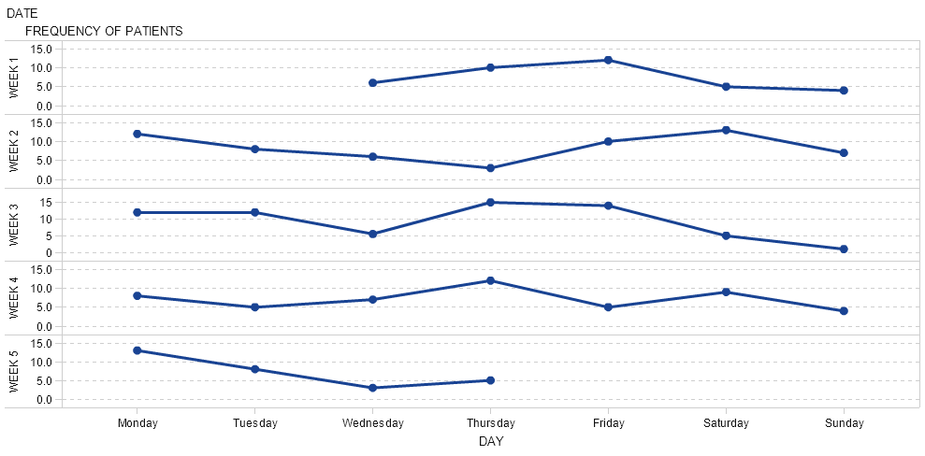
WEEKLY NUMBER OF APPOINTMENTS
Notes:
For consultation, the correlation turns out to be 0.4713. This indicates that older patients take longer for consultation.
Similarly, for crown cementation, the correlation turns out to be 0.4697.
There is no significant linear relationship between age and service time for check-ups and root canals.
For scaling, there is a weak negative linear relationship between the two variables.

Slide 20
BRAINSTORMING
The null hypothesis for scaling is rejected.
The scaling procedure involves removing stains, plaque, tartar and tobacco marks from the patient's teeth.
Setting up the room involves getting a new set of instruments.
The patients could gag during the treatment when the scaling tip is inserted in their mouth. Some patients even feel like vomiting.
Additionally, the scaling tip needs to be changed often if the patient's mouth is very dirty.

Slide 21
CONCLUSION/RECOMMENDATIONS
In order to reduce waiting time, appointments succeeding those with larger variations, should be scheduled with a larger buffer time.
Patients should be informed on how much time their treatment will take approximately, and how much could be their waiting time.
Specialists should be called in on Wednesdays in order to efficiently utilise time.
Promotional offers and packages should be designed to encourage patient re visits.
Patients coming in for scaling should be informed about the procedure and the next appointment should be scheduled with adequate buffer.
Dr. Sandeep Khanna’s absence is the most critical to the company and should be avoided.
The receptionist should appoint the same doctor for each follow-up treatment.
Doctors should educate their patients on dental hygiene.

Slide 22
FUTURE SCOPE
Working with cost data to give more specific and beneficial recommendations.
The data could be collected for a longer period.
Getting supplier side data to obtain the lead times for various equipments.
Data for the other signature smiles branches could be collected for analysis.
Further analysis into all the treatments.

